Slide 1

More Examples of Proofs
Presented by:
Elizer Ponio Jr.
Department of Computer Science
College of Computing and Information Technologies

Slide 2
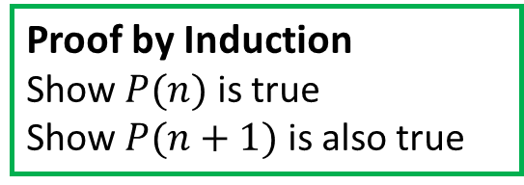

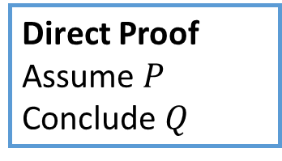

Proof Techniques
We will prove$P ⇒Q$ using the four approaches.
Direct Proof
Assume $P$
Conclude $Q$
Proof by Contradiction
Assume $P$ and $\sim Q$
Get a contradiction
Proof by Induction
Show $P(n)$ is true
Show $P(n+1)$ is also true
Proof by Contrapositive
Assume $\sim Q$
Conclude$P$
In each case, we will prove the following statement:
The square root of an even number is an even number.

Slide 3
Definitions
The square root of an even number is an even number.
Definition 1
An integer number ‘$n$’ is even if and only if there exists an integer ‘$k$’ such that $n=2k$
Definition 2
An integer number ‘$n$’ is odd if and only if there exists an integer ‘$k$’ such that $n=2k$+1
Definition 3
An integer number ‘$a$’ is the square of root of ‘$b$’ if and only if $b=a × a or b=a^{2}$

Slide 4

Definitions
The square root of an even number is an even number.
Can be rewritten as
If The square root of ‘$n$’ is an even number
Then ‘$n$’ is an even number.

Slide 5


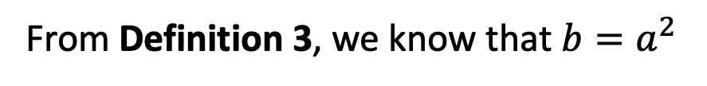


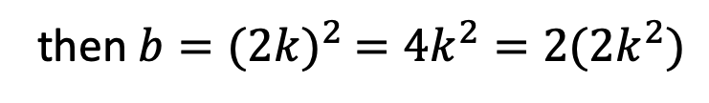
Direct Proofs
The square root of an even number is an even number.
Assume${ a}^{2}$ is even
From Definition 3, we know that $b=a^{2}$
If $a$ is an even number,
then $b={(2k)}^{2} =4k^{2}=2(2k^{2})$
We have shown that$a$ is the square root of $b$
$$∎$$

Slide 6





Proof by Contradiction
Assume: The square root of an even number is an even number.
Assume that the square root of an even number $a$ is NOT even
If the square root of $a$ is NOT even, then no integer $k$ such that $\left(a^{2}\right)=2k$
But we already know that $b=a^{2}$ $={(2k)}^{2}$
Shown that $a^{2}≠{(2k)}^{2}$
Contradict!
But $a^{2}={(2k)}^{2}$
By default, $a^{2}$ is even
$$∎$$

Slide 7


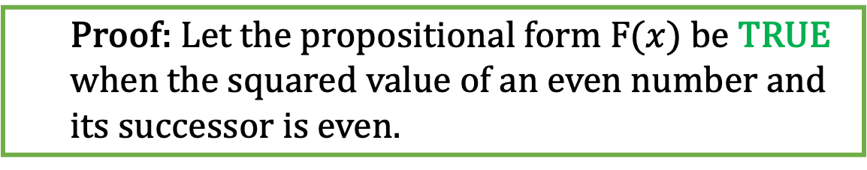



Proof by Induction
Proof: Let the propositional form $F(x)$ be TRUE when the squared value of an even number and its successor is even.
Basis case:
Consider $F(1)$
The squared value of 4 $which is 4^{2}=16$ is even
Assume that $F\left(x\right)$ is TRUE for some $x$, Then $2(2x^{2})$ is even
Base Case:
$$n=2x$$
Induction Step:
$$n=2(x+1)$$
$$n^{2}={4x}^{2}=2(2x^{2})$$
$$n^{2}=2(2{(x+1)}^{2})$$
Claim: Since$2(2x^{2})$ is even, adding 1 to $x$ also gives an even number.
$$∎$$

Slide 8
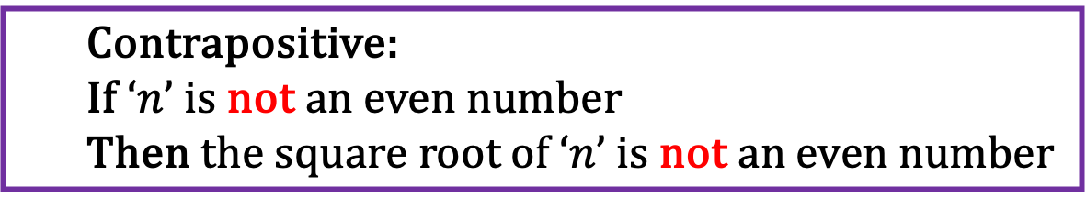
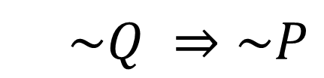

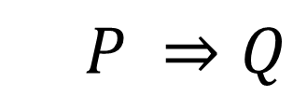


Proof by Contrapositive
$$P ⇒Q$$
If The square root of ‘$n$’ even number
Then ‘$n$’ is an even number.
Contrapositive:
If ‘$n$’ is not an even number
Then the square root of ‘$n$’ is not an even number
$$\sim Q ⇒\sim P$$
Assume that the a is even and $a^{2}$ is not odd. Then, $∄ k∈ ℤ :a^{2}={\left(2k\right)}^{2}$
So… if $a^{2}={\left(2k\right)}^{2}$ does not hold for any integer $k$. But$a^{2}$is the square of $a$
This implies that${ a}^{2}$ is not the square of $a$.
Shown:$\sim Q ⇒\sim P$
$$P ⇒Q$$
$$∎$$

